Slide 1
Vid2World: Crafting Video Diffusion Models to Interactive World Models
arxiv:2505.14357
指導學長：鍾閎凱/吳彥翔
報告人：電機三 賴禹衡/電機三 陳政年

Slide 2
Vid2World Overview
Goal
Propose a general approach that for transferring pre-trained video diffusion model into world model
What this paper want to reach – World model
Action-conditioned (be able to controlled by action prompt) Interactive (be able to input action and output video frame by frame) Autoregressive (be able to output video without seeing the future) video diffusion model
(This part not mentioned in this paper) Afterward, we can apply this world model to downstream tasks For example, training a robot arm (policy model) within the world model

Slide 3
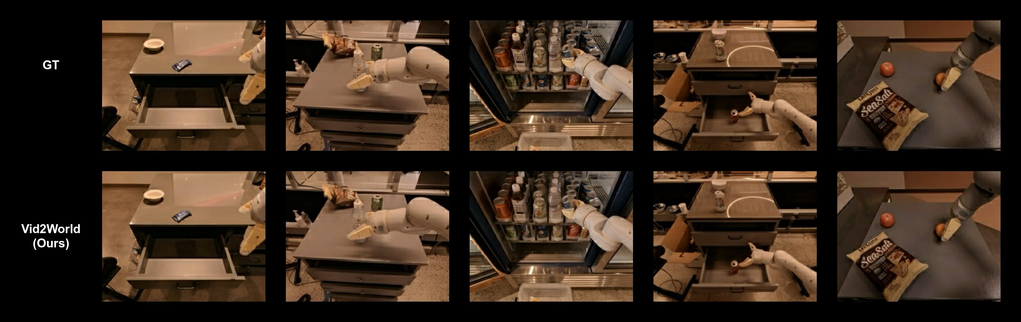
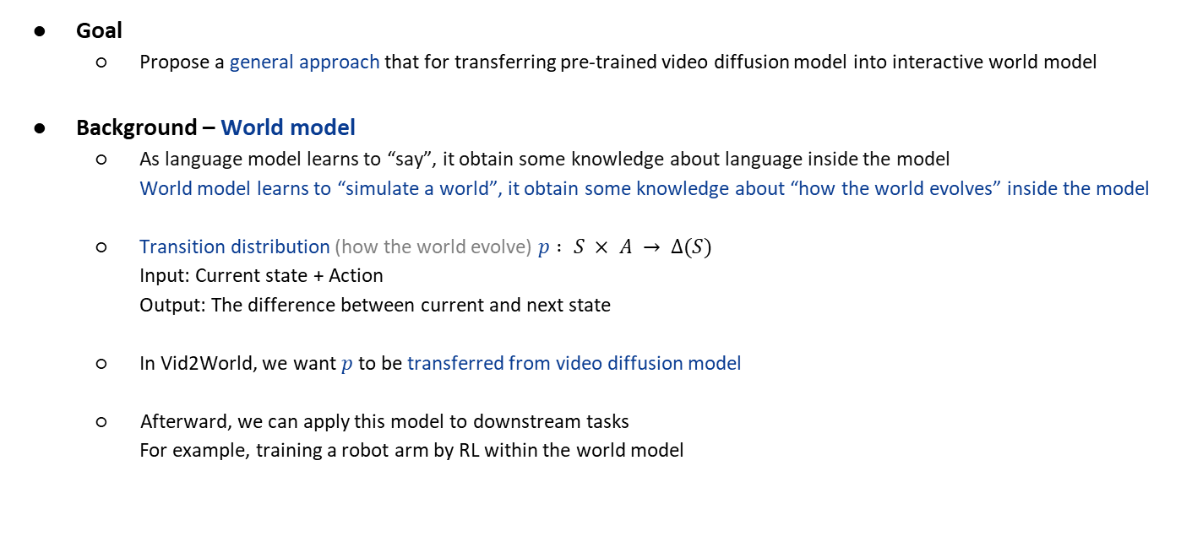
Vid2World Overview
Goal
Propose a general approach that for transferring pre-trained video diffusion model into interactive world model
Background – World model
As language model learns to “say”, it obtain some knowledge about language inside the model World model learns to “simulate a world”, it obtain some knowledge about “how the world evolves” inside the model
Transition distribution (how the world evolve) $p : S × A → ∆(S)$ Input: Current state + Action Output: The difference between current and next state
In Vid2World, we want $p$to be transferred from video diffusion model
Afterward, we can apply this model to downstream tasks For example, training a robot arm by RL within the world model

Slide 4
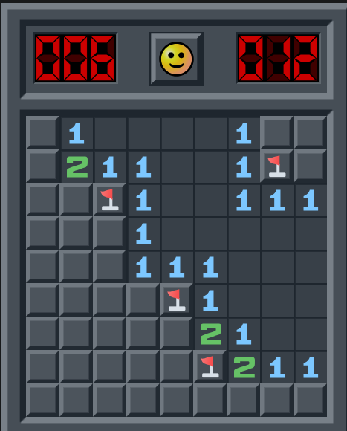
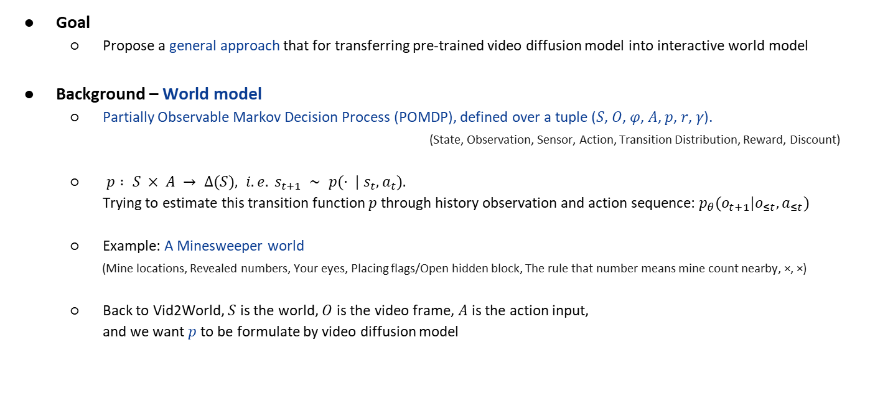
Vid2World Overview
Goal
Propose a general approach that for transferring pre-trained video diffusion model into interactive world model
Background – World model
Partially Observable Markov Decision Process (POMDP), defined over a tuple (𝑆, 𝑂, 𝜑, 𝐴, 𝑝, 𝑟, 𝛾).
(State, Observation, Sensor, Action, Transition Distribution, Reward, Discount)
$p : S × A → ∆(S), i.e. s_{t+1} ∼ p(· | s_{t}, a_{t}).$
Trying to estimate this transition function $p$ through history observation and action sequence: $p_{θ}(o_{t+1}|o_{≤t}, a_{≤t})$
Example: A Minesweeper world (Mine locations, Revealed numbers, Your eyes, Placing flags/Open hidden block, The rule that number means mine count nearby, ×, ×)
Back to Vid2World, $S$ is the world, $O$ is the video frame, $A$ is the action input,
and we want $p$to be formulate by video diffusion model

Slide 5
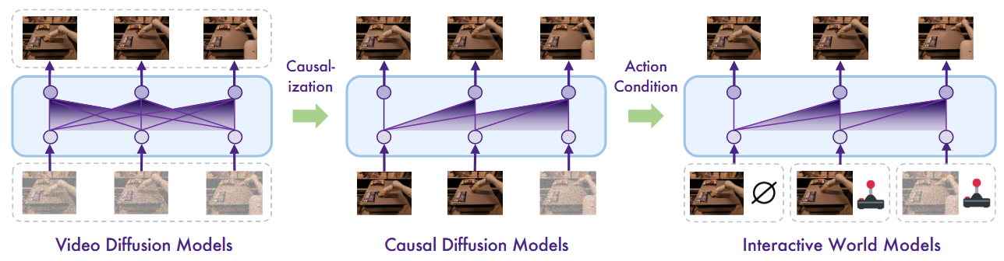
What to modify?
Inability of causal generation
Typical video diffusion models generate frames using bidirectional temporal context, allowing future frames to influence the past, which is undesired for world model
Lack of action conditioning
These models are typically conditioned on coarse, video-level inputs (e.g., text prompts) and lack mechanisms for fine-grained, frame-level action conditioning

Slide 6
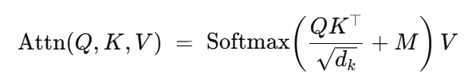
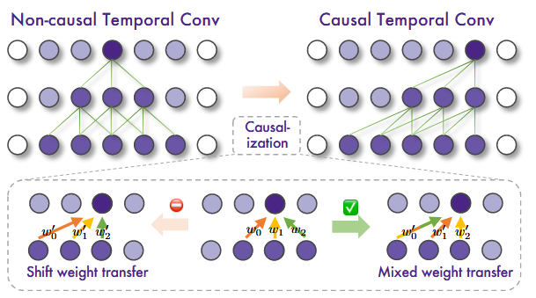
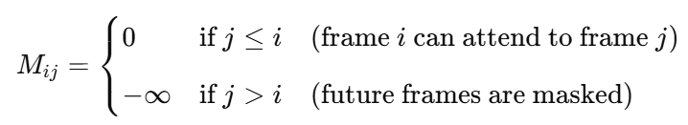
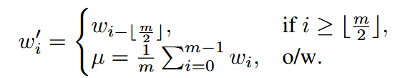
Video Diffusion Causalization
Temporal Attention Layers
Applying causal mask (below detail isn’t mentioned in this paper)
Temporal Convolution Layers
Mixed weight transfer
Diffusion forcing
Model trained with all combination of noise levels in history frames
Model inference with clean history and denoising current frame

Slide 7
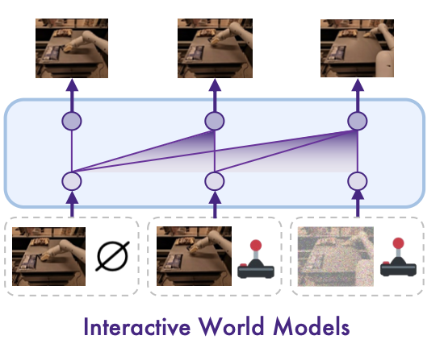
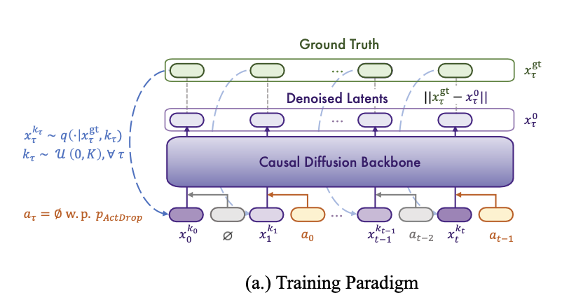
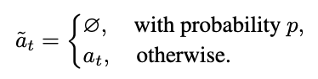

Causal Action Guidance - training
Previous methods
Integrating action condition through video-level condition, where the entire action sequence is encoded to a single embedding.
Vid2world
When predicting the t-th frame $o_{t}$, the embedding of $a_{t−1}$ as action is added to the model’s representation at temporal position
Adding dropout encourages the model to learn the score functions conditioned on all possible subsets of the action sequences.
lack the ability to perform frame-level fine-grained
action-conditioned predictions
Notes:
每一幀的動作嵌入：每個幀根據其對應的動作生成，使模型能夠根據當前的動作來影響下一幀的生成過程。
動作隨機丟失 (Action Dropout)：在訓練過程中，隨機丟棄某些幀的動作，使得模型在訓練過程中學會處理有動作與無動作的情境。

Slide 8
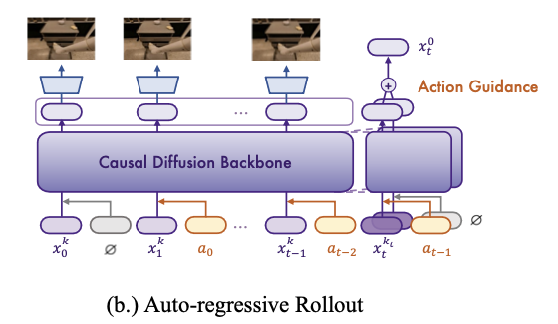
Causal Action Guidance - sampling
Vid2world
To add flexibility to the level of control in the generated frames, extend classifier-free guidance to action-conditioned generation in auto-regressive setting
At inference time, guide the model’s generation to help the model support counterfactual reasoning conditioned by the most recent action the agent takes.

Slide 9
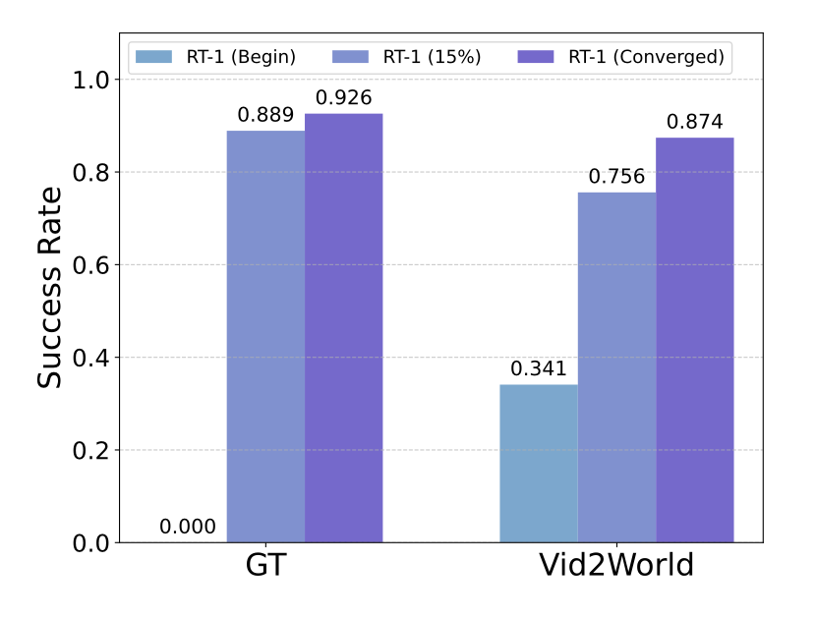
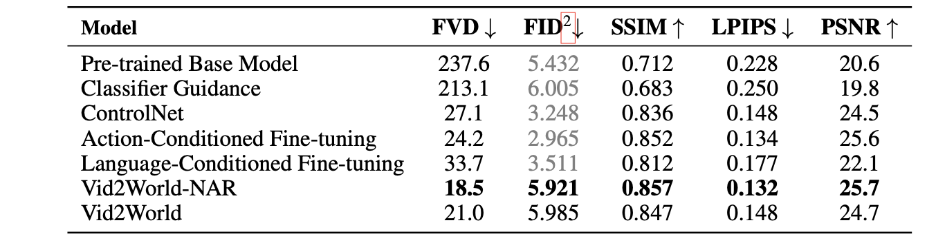
Experiment
Real2Sim Policy Evaluation
RT-1: robotic experiences spanning multiple manipulation tasks
Quantitative results for RT1 dataset
Notes:
大量真實機器人操作的數據
驗證 Vid2World 方法在 現實世界任務模擬 中有效性

Slide 10
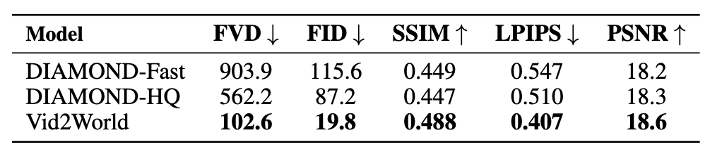
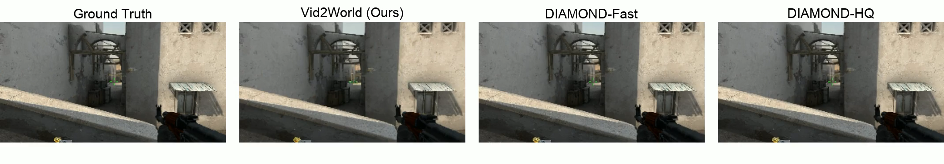
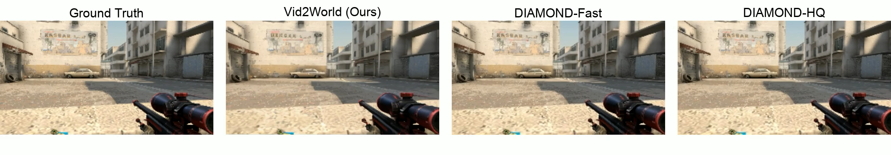
Experiment
CS:GO: real-time user interaction on CS:GO
Quantitative results for CS-GO dataset

Slide 11
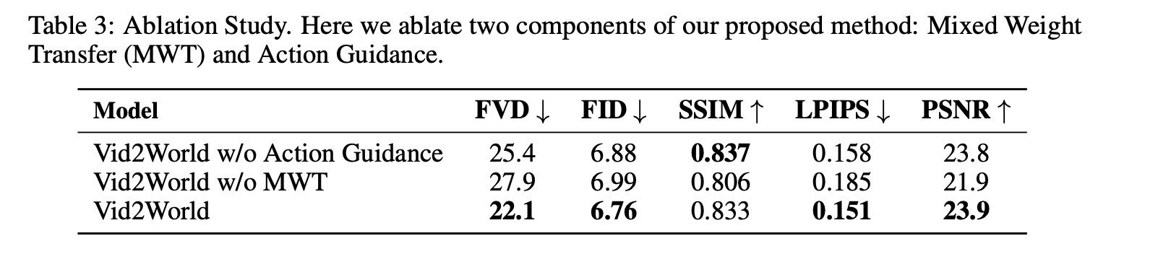
Ablation Study
How important is the model’s ability to perform action guidance in interactive video prediction settings?
Does the proposed mixed weight transfer induce better transfer in video prediction tasks?

Slide 12
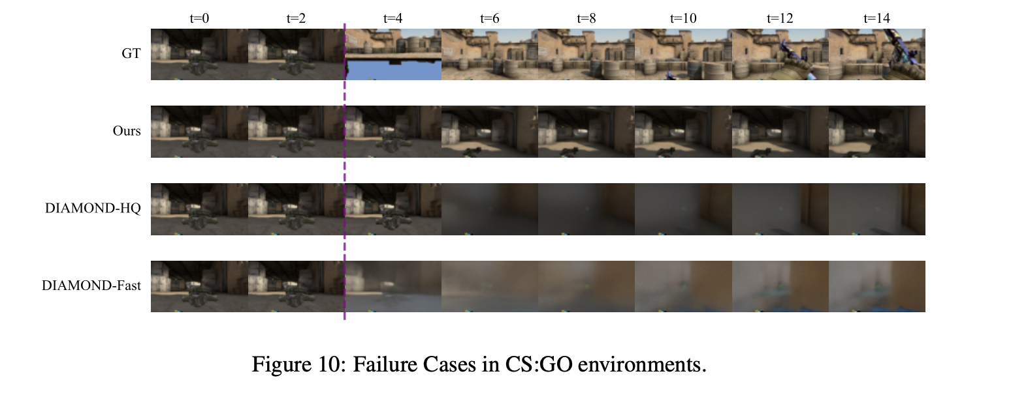
Drawback
The environment’s randomness which adds to the difficulty (respawn).

